Slide 1
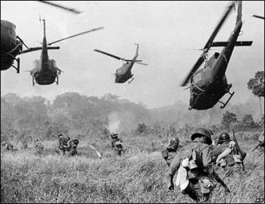
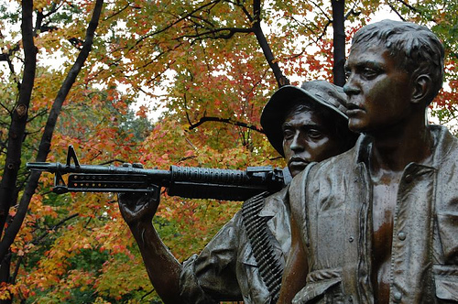
Westchester County Veteran Services
Charlotte Trotter, Veterans Service Officer
Deputy Director

Slide 2
WESTCHESTER COUNTY VETERANS SERVICE AGENCY
VA Pensions & Compensations
VA Burial Benefits
VA Property Tax Exemption
VA Group Life Insurance
VA Healthcare ID Card Enrollment Days
Veterans Real Property Tax Exemption
Securing Military and Personal Records
Obtaining Medals and Awards Referrals
VA Vocational Rehabilitation & Employment Benefits
VA Education Benefits

Slide 3
Mission Statement
To ensure that veterans and their dependents receive the maximum benefits from the federal Department of Veterans Affairs and other agencies at all levels of government.
To promote the interests and welfare of veterans, their dependents and survivors and to enhance their quality of life through free accredited representation, counseling, claims assistance, education, advocacy and special projects.
Work closely with the United States Department of Veterans Affairs and other federal, state, local, and private agencies to provide optimal service at the local level.

Slide 4
Benefit Eligibility
Who's Eligible
Eligibility for most federal, state and local benefits is based upon discharge from active military service under other than dishonorable conditions.
90 days of service during wartime and/or conflict periods
or two years of military service since 1980 or 181 days during peacetime
War Time Service
Some VA benefits and medical care require wartime service. As specified in law, the VA recognizes these war periods:
World War II (September 16, 1940 to July 25, 1947)
Korean Conflict (June 27, 1950 to January 31, 1955)
Vietnam Era (August 5, 1964 to May 7, 1975)
Persian Gulf War (August 2, 1990 to present) requires service for 2 years or the full period for which called to active duty. Exceptions applying to service between September 7, 1980 and August 1, 1990 also apply to Persian Gulf War.
You must have served at least 90 days on active duty and must have been discharged or released under other than dishonorable conditions. If you served less than 90 days, you may be eligible if discharged because of a service-connected disability.

Slide 5
Benefit Eligibility cont.
Peacetime Service
If your service fell entirely within any one of the following periods:
July 26, 1947 to June 26,1950
February 1, 1955 to August 4, 1964
May 8, 1975 to September 7, 1980 (if enlisted) or to October 16, 1981 (if officer).
You must have served at least 181 days of continuous active duty and you must have been discharged or released under conditions other than dishonorable. If you served less than 181 days, you may be eligible if discharged because of a service-connected disability.
Family and Survivor
Dependency and Indemnity Compensation
DIC payments to surviving spouse
DIC payments to parents and children
Spina Bifida benefits
Medical Care for family and survivors (CHAMPVA)
Widows Pension
Burial of spouse and eligible family members
Educational benefits
Home Loan Guaranty for surviving spouse

Slide 6
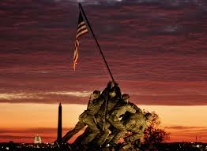
Benefits and services
Survivor and Death Benefits
Service connected death benefits
(Dependency and Indemnity Compensation)
Non-service connected death benefits
(Widow/Widower Pension)
VA burial allowances
Government burial markers/headstones
Bronze star grave flag holders
Government life insurance claims
U.S. burial flags
Calverton National Cemetery
Replacement medals

Slide 7
Benefits and services cont.
Health Benefits
VA medical care enrollment
(inpatient & outpatient)
Chemical dependency treatment
TRICARE
CHAMPVA (Civilian Health And Medical Program VA)
Disabled Veteran Benefits
Service connected VA compensation claims
Non-service connected VA disability pension claims
Service disabled veteran’s life insurance
VA vocational rehabilitation
VA appeals assistance
Special Adaptive Housing Grants
Automobile and Special Adaptive Equipment Grants

Slide 8
Benefits and services cont.
Disabled Veteran Benefits
Service connected VA compensation claims
Non-service connected VA disability pension claims
Service disabled veteran’s life insurance
VA vocational rehabilitation
VA appeals assistance
Special Adaptive Housing Grants
Automobile and Special Adaptive Equipment Grants
Education Benefits
GI Bill for college, vocational and apprenticeship training
Dependent & Survivor Education (Chapter 35)
Assistance for Recently Discharged Veterans

Slide 9
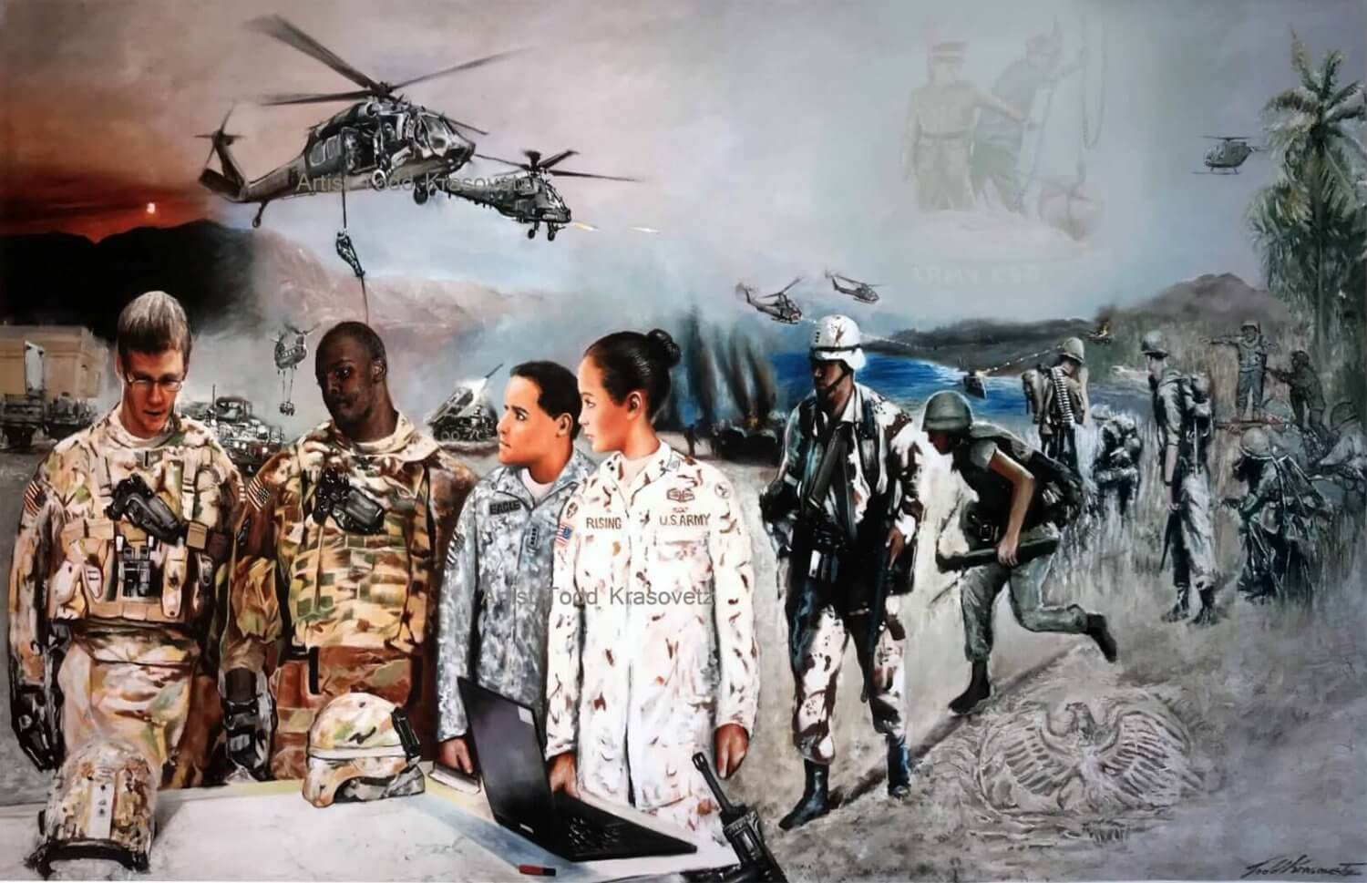
Other benefits
State Veterans Home
Civil Service Preference
Homeless Veterans Programs
Overseas benefits
State Benefits
Free camping privileges
Free hunting/fishing licenses
Free boat trailer registration fees and taxes
Free handicapped parking card
Free watercraft registration
Free tuition for family members for some state colleges and universities
Job counseling, Westchester County and New York State Department of Labor
New York State Blind Annuity Pension

Slide 10
Resources FOR VETERANS
Family Services of Westchester (FSW.org)
Andrea Molina Director of Veteran Services, Vet2Vet amolina@fsw.org 914-358-4240
Jessica Encarnacion Case Manager/Veteran Spouse Peer Facilitator jencarnacion@fsw.org 914-358-4239
Veterans Outreach and Support 106 North Broadway White Plains, NY 10606
White Plains Vet Center (Readjustment counseling/Family Counseling) #914-682-6250
Services for the Underserved (Peer counseling/Case Management) #844-787-6722
Veterans Crisis Line #800-273-8255 press 1
Legal Services of Hudson Valley (Veterans and Military Families Advocacy Project) #877-574-8529

Slide 11
Resources for Veterans (CONT.)
Employment Resources
Westchester County One-Stop Employment #914-995-4976 and 914-995-4561
VA for Vets (Employment) #855-824-8387 and 917-301-4701
Homelessness/Housing/Patriot Housing
Westchester Veterans Housing caseworker – Paul #914-737-4400 x3740
National Veteran Homeless #1-87-424-3838
Jan Peek Shelter – Veterans Transitional Housing #914-736-2636
Breaking Ground-Montrose – Veterans Transitional Residence #914-606-3480 and 914-606-3499
Department of Social Services (DSS) Office of Temporary Housing Assistance 914-995-3333
(Emergency # for families: weekends/afterhours) 914-995-2099

